Slide 1
Generalised Autocorrelation Function (GACF)
Updates 07/03/2018

Slide 2
Overview
GACF basics
Lars’s paper
C++ implementation
Python wrapper
Period extraction using FFT & peak detection
Application to real NGTS data
Noise threshold calculations

Slide 3
Lars’s Paper
https://www.overleaf.com/12550376jxwkqknjtqqp#/47821890/
Introduction
ACF
GACF
Lag
Selection function
Weight function
Reduction to ACF for regular sampling
Discussion (simple examples?)
Conclusions

Slide 4
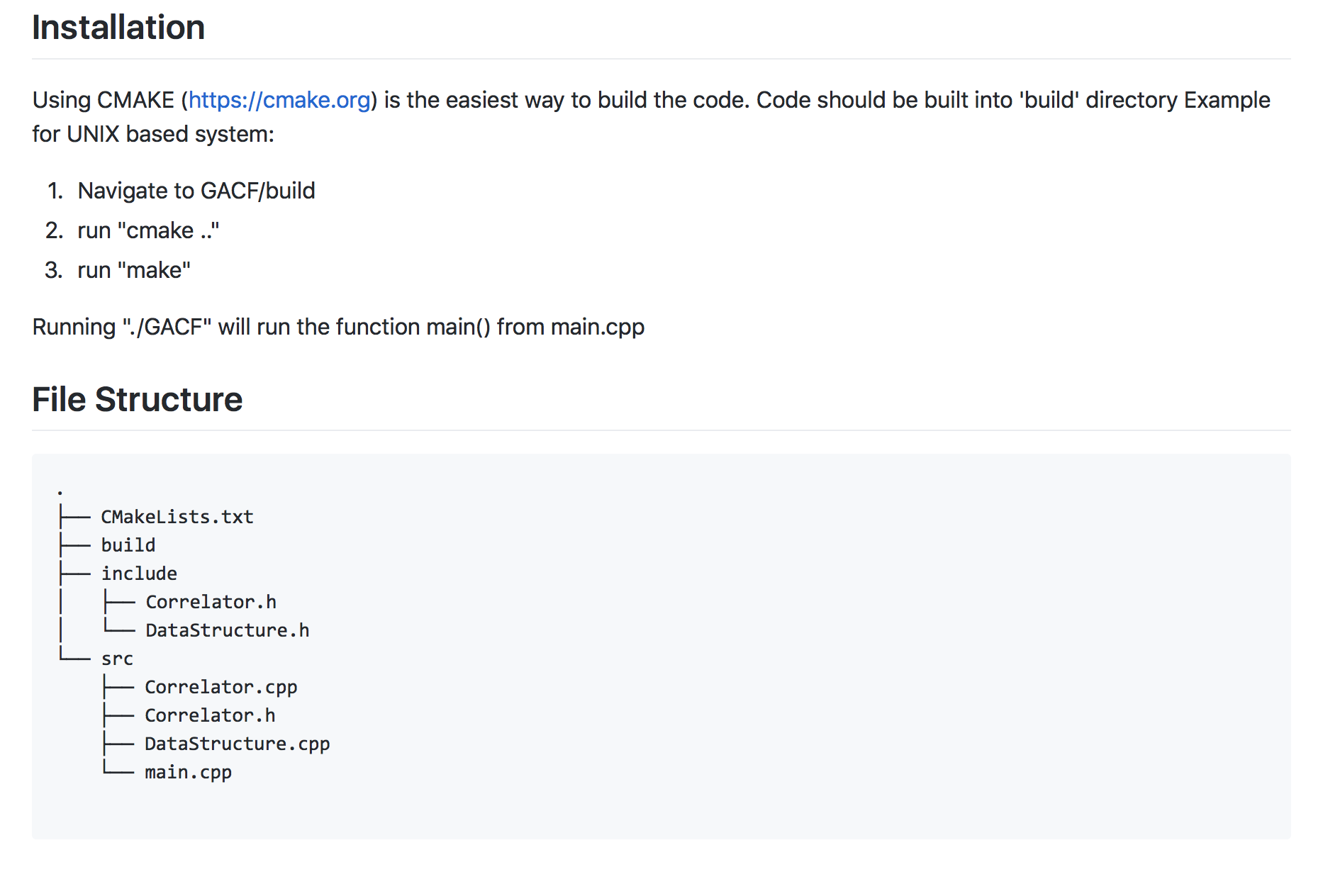
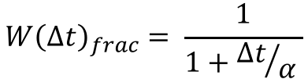

C++ implementation
$${W\left(Δt\right)}_{frac}= \frac{1}{1+{Δt}/α }$$
https://github.com/joshbriegal/GACF
Branch: ‘pure-C++-code’
Hardcoded file locations / generated data in main.cpp
$${W\left(Δt\right)}_{Gauss}= e^{−\frac{{(Δt)}^{2}}{{2α}^{2}}}$$
Input vectors (time series & data points from vectors or file)
GACF:
Selection Function
Weight Function
Lag time step
Output vectors (lag time series & correlation data points) to file
Selection functions – Fast (not good) or Natural
Weight functions – linear or half-Gaussian with length scale. Definitions above differ slightly to current paper definition

Slide 5
C++ implementation details (non-examinable)
DataStructure object
Read in time series, data points & errors
Calculate mean, median & normalised series
Correlator object
Pointer to DataStructure object
Normalisation constant, max_lag, lag_resolution, alpha (length scale of weight function)
CorrelationData contains lag timeseries & correlation values
CorrelationIterator object
Handles each lag time step of the correlation
Shifted time series, selection indices, time differences & weights
Returns one correlation value and one lag time step

Slide 6
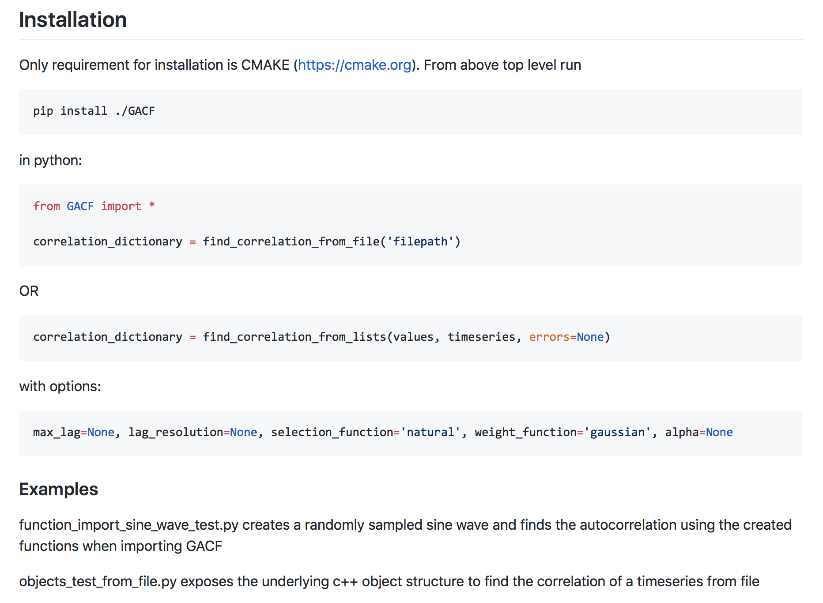
Python Wrapper
https://github.com/joshbriegal/GACF
Branch: ‘master’
Uses pybind11 to expose pure C++ code
Pip installable (not on PyPI yet)
Returns a dictionary:
{‘lag_timeseries’:[x], ‘correlations’: [x]}

Slide 7
Code ’TODOs’
More robust file reading (currently only accepts files in one format as tab delimited columns)
More robust error handling in C++ (e.g. empty time series causes exit code 11 segmentation fault!)
Performance:
0.0631980895996 seconds for 984 data points / lag time steps
3.32579088211 seconds for 9985 data points / lag time steps
0.231755018234 seconds for 9982 data points / 700 lag time steps
66.3709959984 seconds for 199,981 data points / 8448 lag time steps (5 min resolution on 12 second cadence NGTS light curve)
Time to do the rest of the stuff 1 - 4 seconds dependent on number of points

Slide 8
Period Extraction using FFT & peak detection in Python
Input data
Lag time series & correlations
FFT
Peak detection
Period interpolation (manual)
GACF
numpy
peakutils
custom
FFT
Fast & accurate periodicity detection for regular time series
Peakutils
Extract peaks from data. Requires threshold (% of max peak) and width (no of data points) -> FFT point density not uniform in period
Period interpolation
Take extracted period from FFT, fit to autocorrelation on first 3 periods and average

Slide 9
Period Extraction using FFT & peak detection in Python (e.g. 0409-1941_009529_LC_tbin=10min)
periods before pruning: [1.4642287337978166]
peak periods: [1.4642287337978166]
peak amplitudes: [201.3234954473777]
peak percentages: ['100.0%']
interpolated periods: [1.4732172465897022]
Notes:
Can we weight points in FFT? Earlier peaks more important / reliable.
Plot FFT in log.
Cull periods > 1/2 time series.

Slide 10
Application to NGTS data
Ran on ~ 100 light curves from TEST18, field 0409-1941
Light curves binned to 10 minutes (median flux)
When compared to Vedad’s extracted LS periods we see:
For obvious periods (e.g. prev example) LS will give harmonics, GACF does not
For less obvious periods (e.g. below) both methods give nonsense
Object 9859 Vedad periods: [[8.671760265098161, 2.1816488110477303, 4.335880132549081]] (double [1]) GACF periods: [4.31582959204128]
Object 11035 Vedad periods: [[0.4996555774966044, 1.0550831078330438, 1.1627757505199026]] (double [1]) GACF periods: [17.25695161, 120.79866128, 34.51390322, 48.31946451, 10.06655511]
Notes:
Work out best binning for both light curve and for GACF. 20 minutes sensible.

Slide 11
Application to NGTS data
Object 9859 Vedad periods: [[8.671760265098161, 2.1816488110477303, 4.335880132549081]] (double [1]) GACF periods: [4.31582959204128]
Object 11035 Vedad periods: [[0.4996555774966044, 1.0550831078330438, 1.1627757505199026]] (double [1]) GACF periods: [17.25695161, 120.79866128, 34.51390322, 48.31946451, 10.06655511]

Slide 12
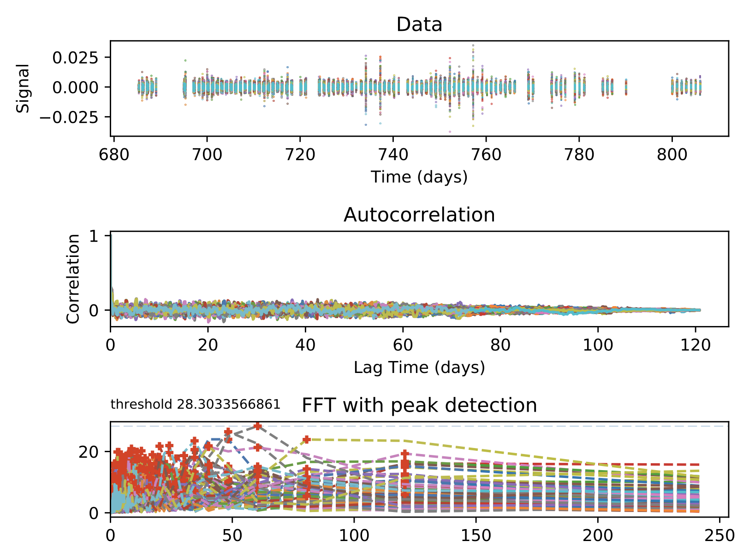
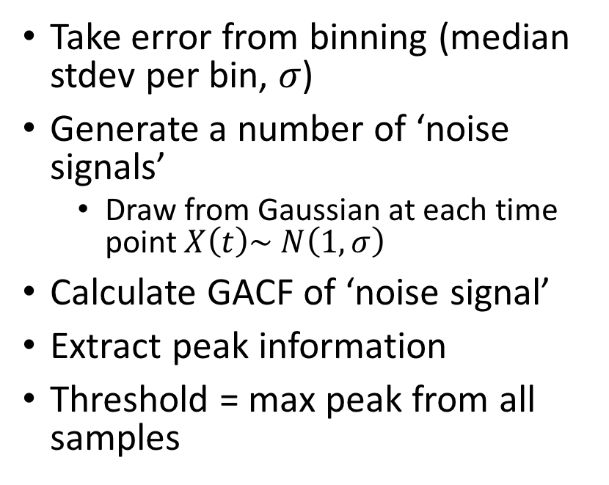
Noise threshold calculations
Take error from binning (median stdev per bin, 𝜎)
Generate a number of ‘noise signals’
Draw from Gaussian at each time point $X\left(t\right)\sim N\left(1, σ\right)$
Calculate GACF of ‘noise signal’
Extract peak information
Threshold = max peak from all samples

Slide 13
Noise threshold calculations
Problems:
Need many samples – slow to calculate
Does the peak size match the same noise if a signal is present?
Signal to noise ratio
Shape of signal itself
Noise assumed uncorrelated
OK assumption given binned data?
OK assumption given speed? How would we consider red noise?

Slide 14
Noise threshold calculations
Considered effect of noise signal on injected sine wave of different depths
Conclusions unclear, not sure if worth pursuing

